Slide 1
Hardware and Locomotion
Adapted from
David V Lu

Slide 2
Robot Hardware
Actuators / Motors
Sensors
Computation/Communication
Power

Slide 3
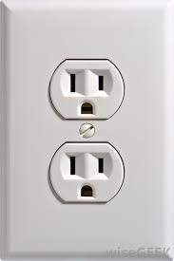
With Great Power
Primary Hardware Concern
Trade off: Batteries vs. Cords

Slide 4
With Great Power
Primary Hardware Concern
Trade off: Batteries vs. Cords

Slide 5
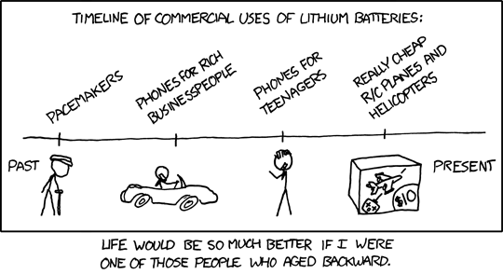
Batteries
Heavy
Hazardous: lead/acid technology
Limited Life Span
Swapping
Batteries
Recharging

Slide 6
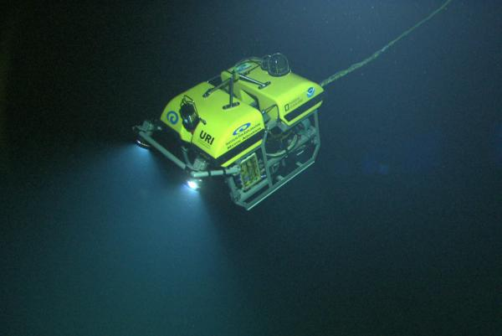
Tethered Robots
Effectively unlimited power
(and communication)
Very little weight
Limits Range
Limited
Environments

Slide 7
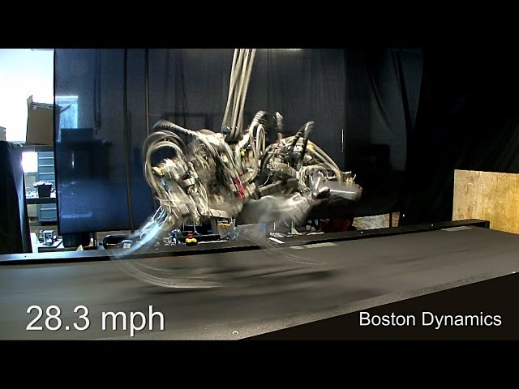
Boston Dynamics Cheetah

Slide 8
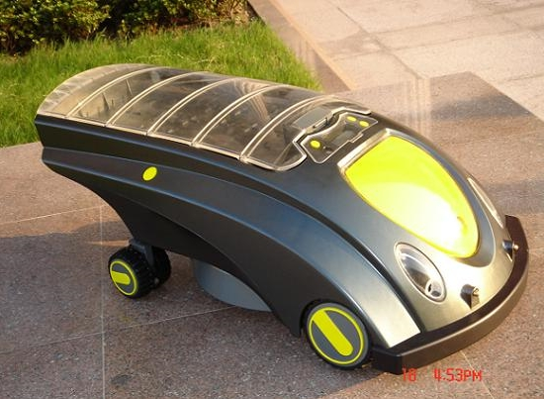
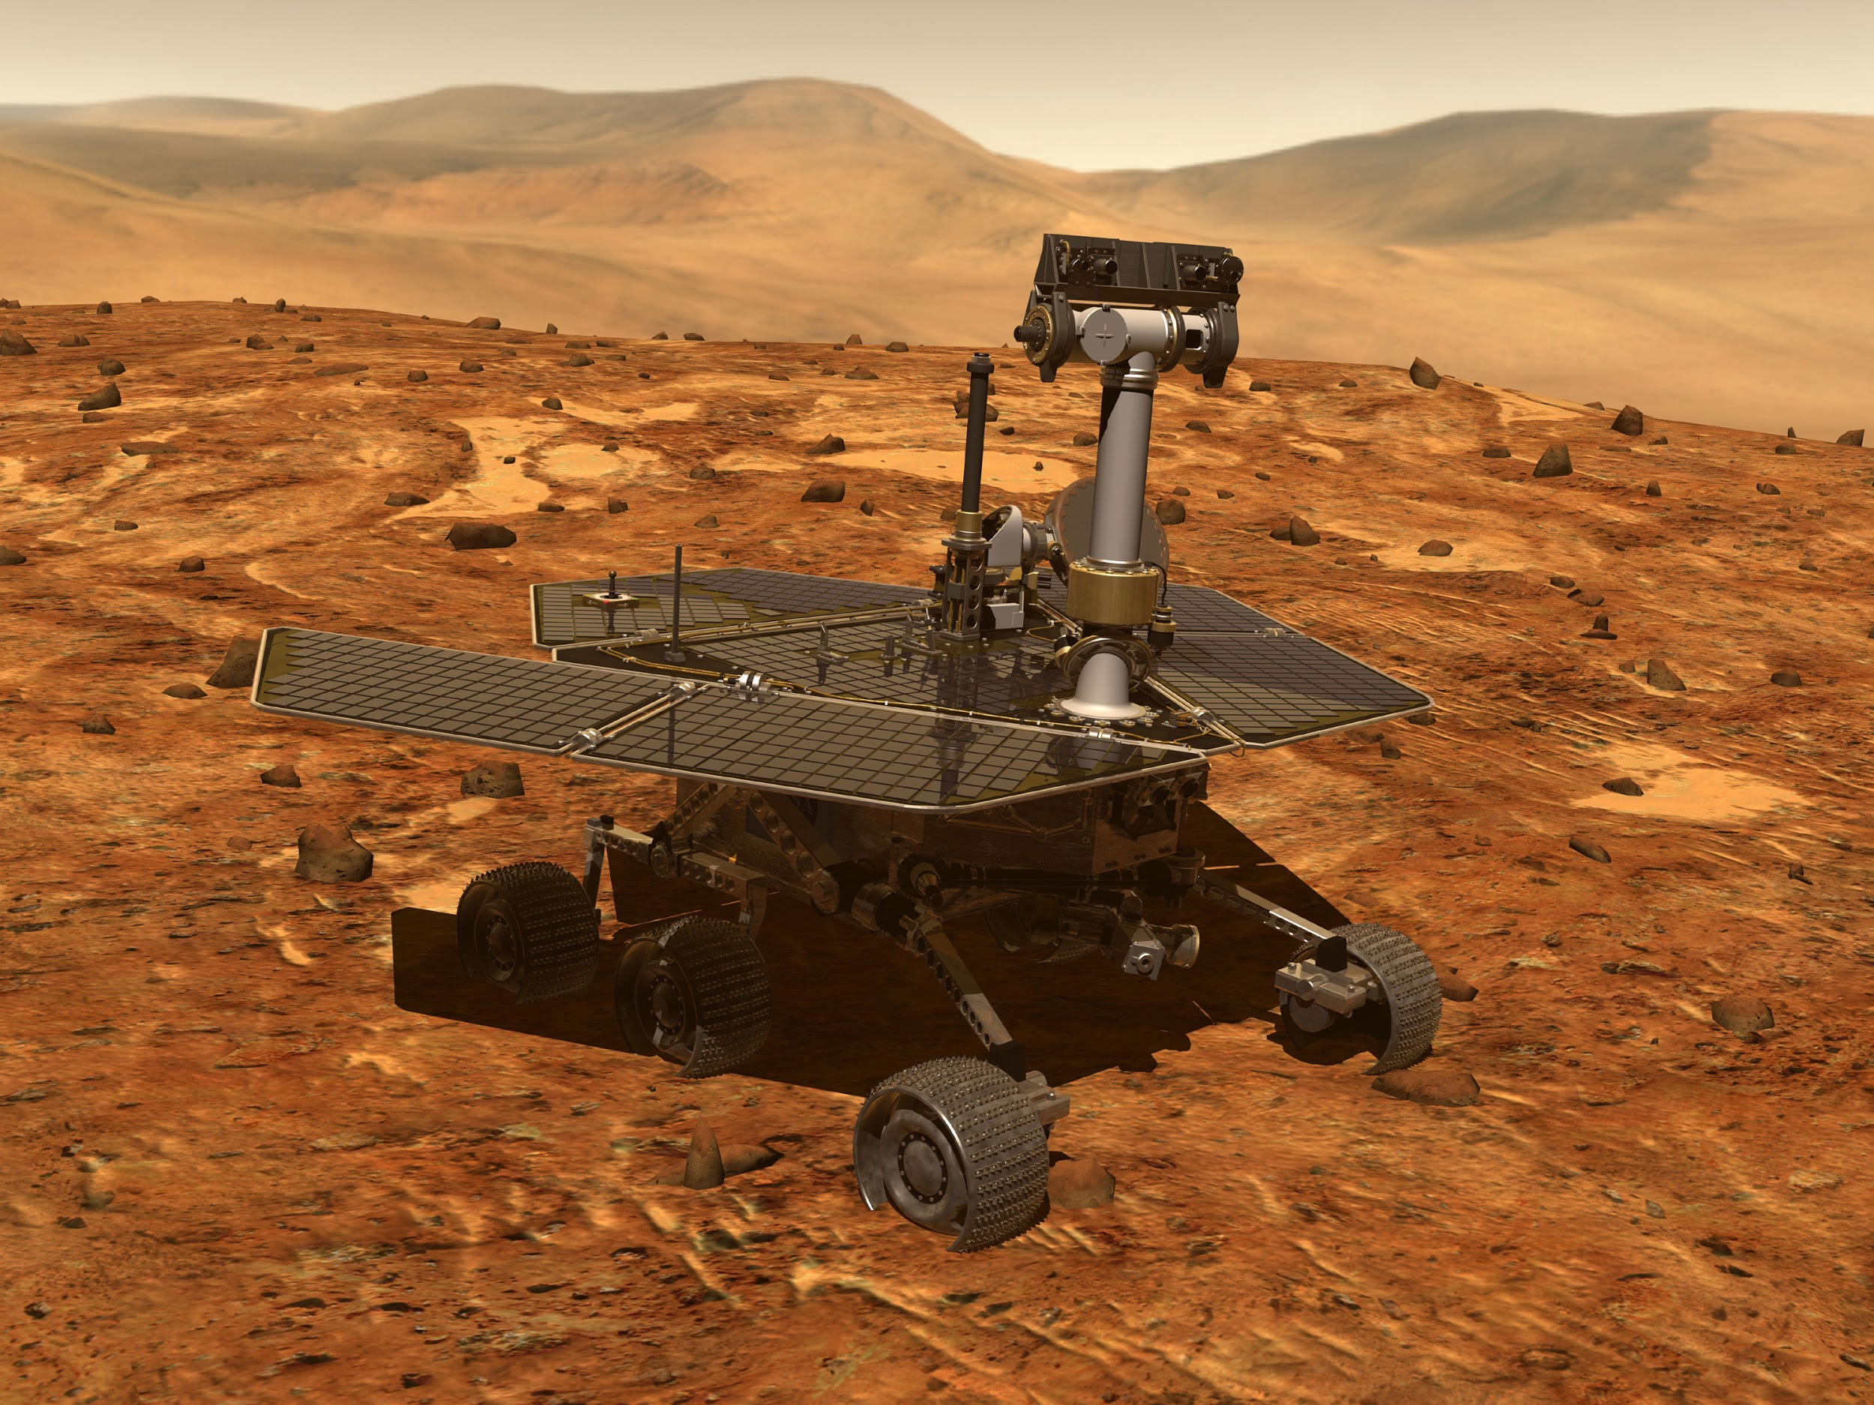
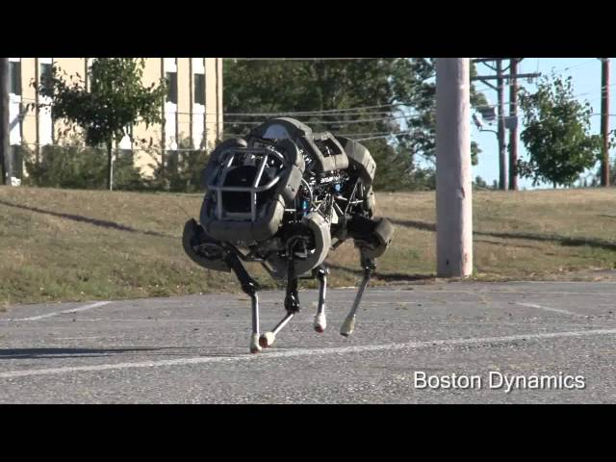
Other Options
Solar
Internal Combustion

Slide 9
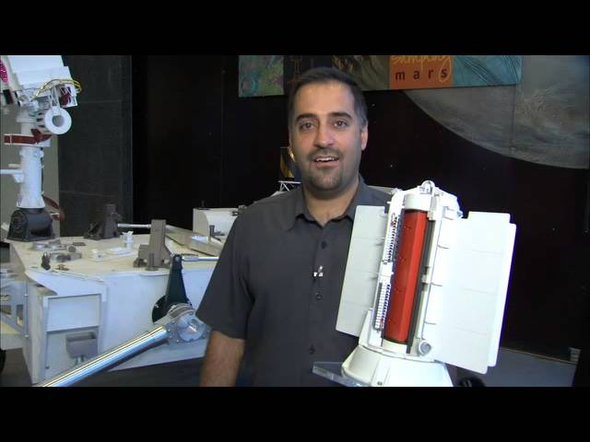
More Options
Radioisotope Themoelectric Generator

Slide 10
Locomotion
Wheels
Legs
Propellors/Wings
Thrusters/Jets

Slide 11
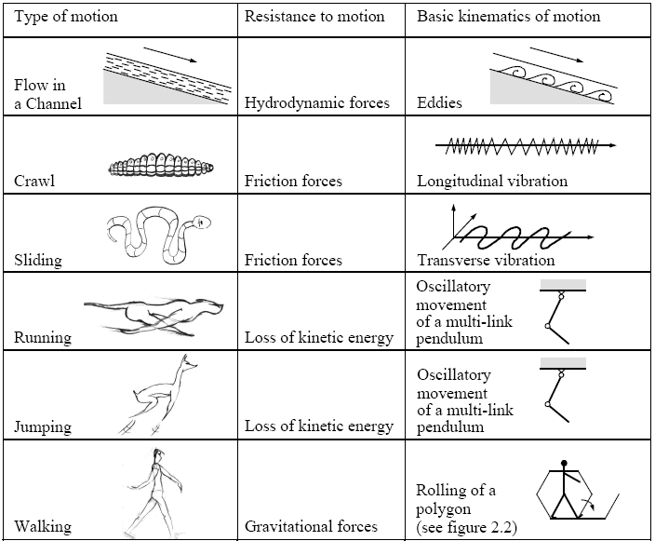
Locomotion Concepts: Principles Found in Nature
R. Siegwart

Slide 12
Locomotion Concepts
Concepts found in nature
difficult to imitate technically
Most technical systems use wheels or caterpillars
Rolling is most efficient, but not found in nature
Nature never invented the wheel !
However, the movement of a walking biped is close to rolling
Notes:
On constate que la technologie dont nous disposons ne permet pas de reproduire des machines capables d'imiter ce que la nature à su créer. Cette dernière dispose d'outils comme la réplication cellulaire et la spécialisation qui lui permet de créer des structures complexes miniaturisées et fonctionelles. De plus le système de stockage d'énergie ainsi que les systèmes musculaires que l'on trouve dans la nature possèdent des caractéristiques de rendement qui sont nettement supérieures aux batteries et aux moteurs inventées par l'homme.
Du à ces limitations techniques, la plupart des robots mobiles crées par l'homme utilisent des roues. Il est intéressant de constater que ce mécanisme de locomotion n'était jamais apparu dans la nature avant que l'homme ne le découvre et ne le fasse évoluer. On peut tout de même constater que la marche d'un bipède peut s'apparenter à un polygone qui roule.

Slide 13
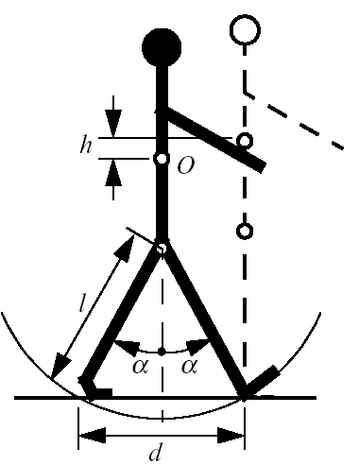
Biped Walking
Biped walking mechanism
not to fare from real rolling.
rolling of a polygon with side length equal to the length of the step.
the smaller the step gets, the more the polygon tends to a circle (wheel).
However, fully rotating joint was not developed in nature.

Slide 14
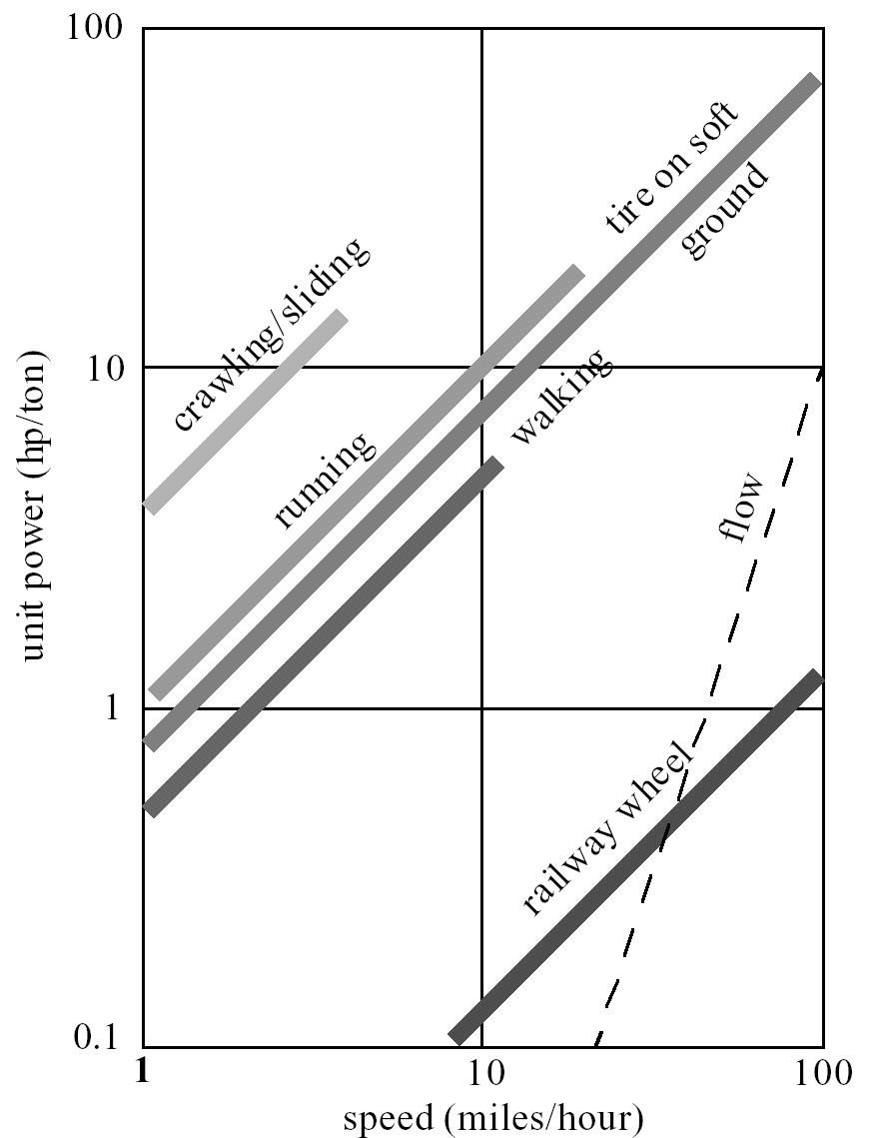
Walking or rolling?
number of actuators
structural complexity
control expense
energy efficient
terrain (flat ground, soft ground, climbing..)
movement of the involved masses
walking / running includes up and down movement of COG
some extra losses

Slide 15
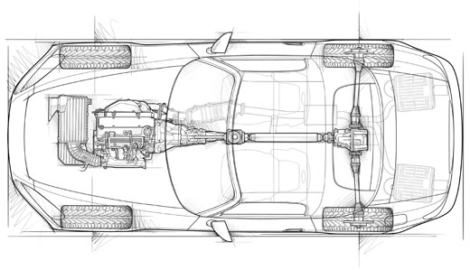
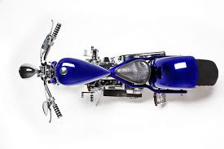
Stability
Static Stability - can balance without being active
Dynamic Stability - Needs active control to stay upright (stable when moving)

Slide 16
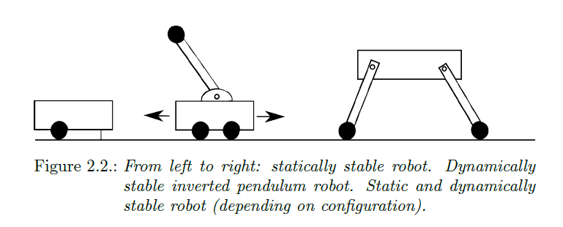

Slide 17
Stable Configurations
Projection of the center of mass must fall within the support polygon

Slide 18
Mobile Robots with Wheels
Wheels are the most appropriate solution for most applications
Three wheels are sufficient to guarantee stability
With more than three wheels an appropriate suspension is required
Selection of wheels depends on the application

Slide 19
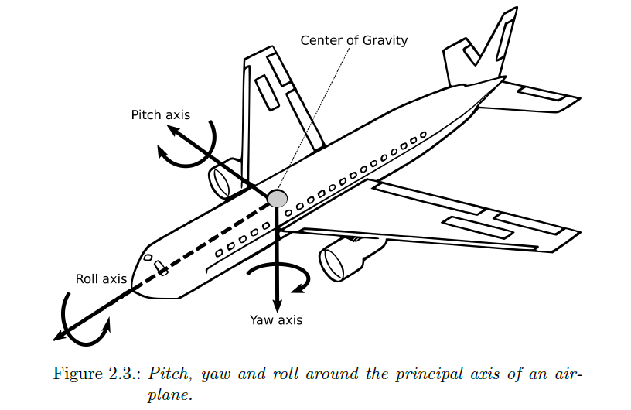
Degrees of Freedom (DOF)

Slide 20
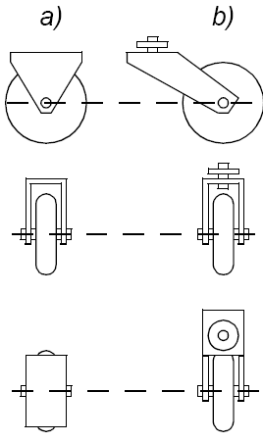
The Four Basic Wheels Types
a) Standard wheel: Two degrees of freedom; rotation around the (motorized) wheel axle and the contact point
b) Castor wheel: Three degrees of freedom; rotation around the wheel axle, the contact point and the castor axle
- used in office chairs

Slide 21
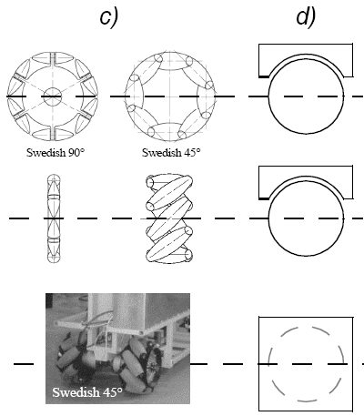
The Four Basic Wheels Types
c) Swedish wheel: Three degrees of freedom; rotation around the (motorized) wheel axle, around the rollers and around the contact point
d) Ball or spherical wheel: Three degrees of freedom, around contact point in any direction
- Suspension technically not solved

Slide 22
Ackerman Steering - Four Wheels
Two Active Fixed Wheels in Back
Two Passive Steerable Wheels in Front

Slide 23
Bike Steering - 2 Wheels
One Active Fixed Wheel in Back
One Passive Steerable Wheel in Front

Slide 24
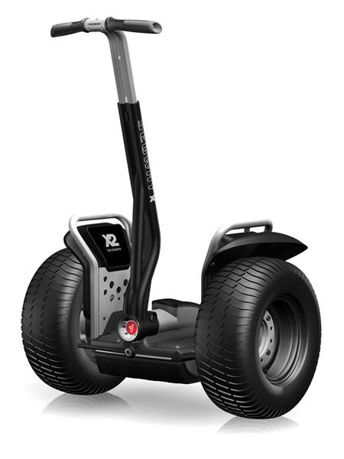
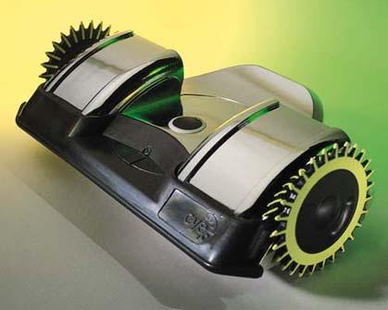
Segway - 2 Wheels
Cye Personal Robot
Two Active Wheels
Center of Mass below Axle

Slide 25
Differential Drive
Equal Wheel Velocity
Top Wheel Faster
Forward Kinematics
(more on this later)

Slide 26
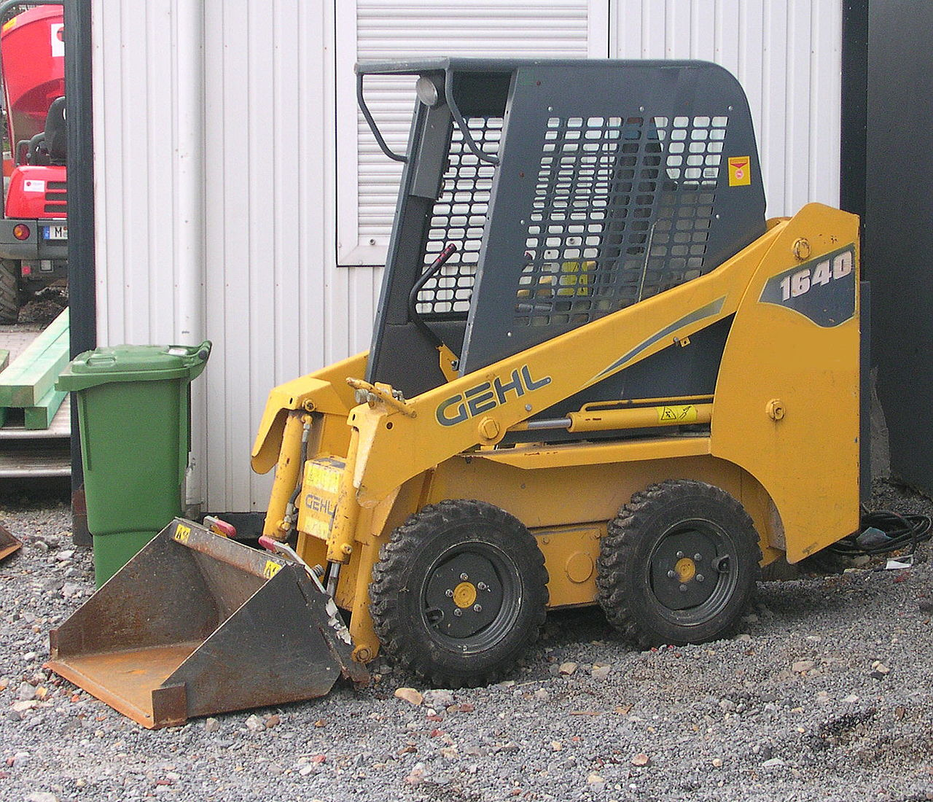
Skid Steering - Four Wheels
Four active fixed wheels

Slide 27
Two+One - Three Wheels
Two Active Fixed Wheels in Back
Point of Contact / Castered Wheel in front

Slide 28
Turtlebot
Two Active Wheels
One Caster Wheel
One Passive Wheel

Slide 29
PR2 - Four Wheels
Four steerable active wheels

Slide 30
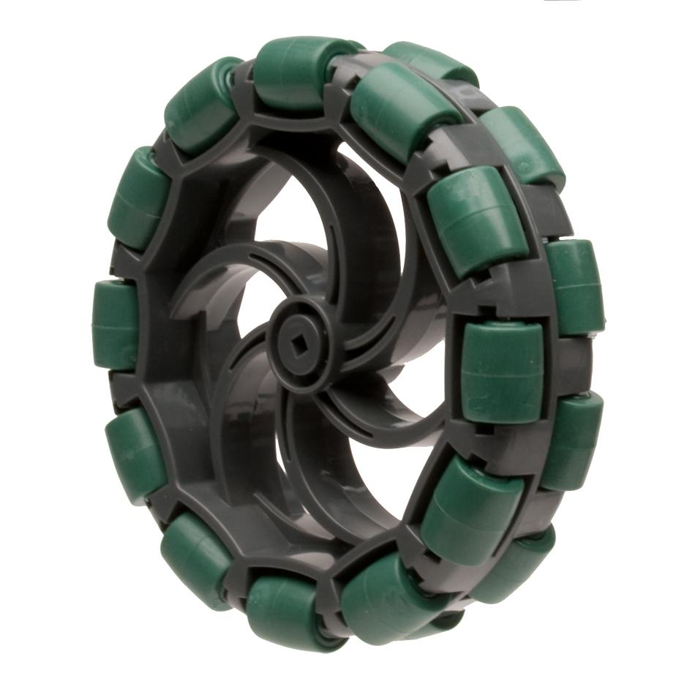
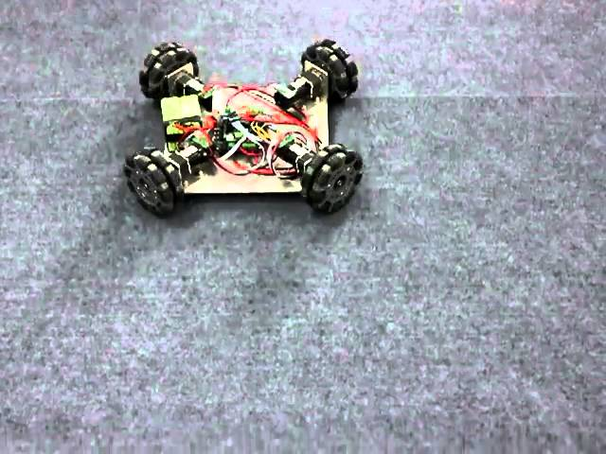
Omniwheels
Slide Laterally With Ease

Slide 31
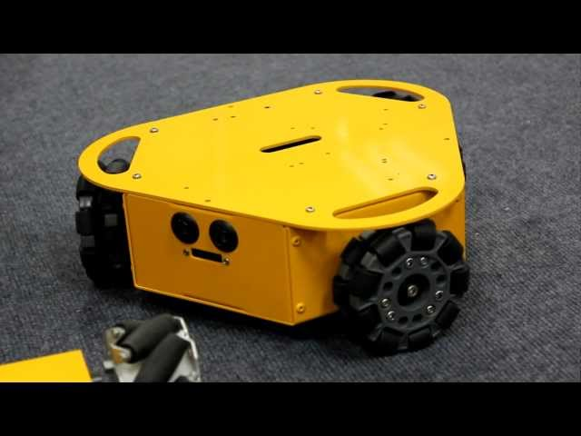
Three Omniwheels

Slide 32
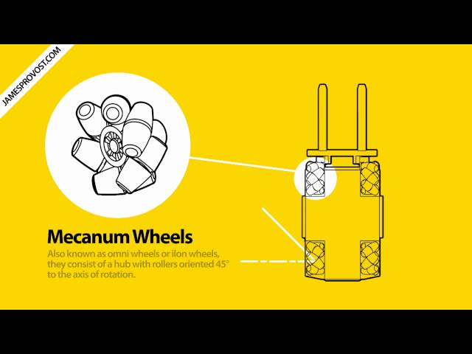
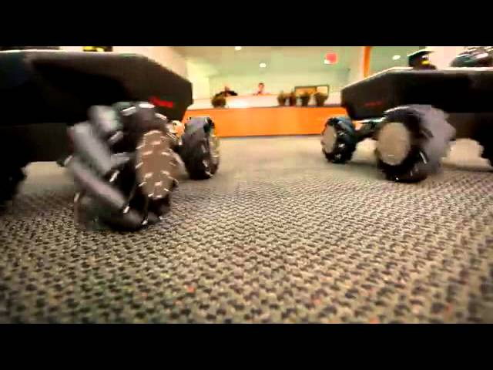
Swedish / Mecanum Wheels

Slide 33

The World is Flat!

Slide 34
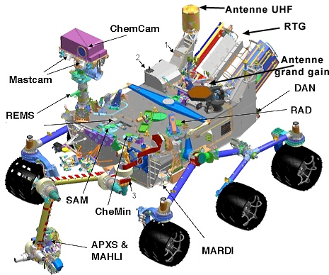
Rocker Bogie - Six Wheels

Slide 35
Legs
Can Deal with Rough Terrain
Quality of Ground Matters Less
Can Cross Holes
Power Needs
Mechanical Complexity
More complex kinematics

Slide 36
Mobile Robots with legs (walking machines)
The fewer legs the more complicated becomes locomotion
Stability - at least three legs are required for static stability
During walking some legs are lifted
thus loosing stability?
For static walking at least 6 legs are required
babies have to learn for quite a while until they are able to stand or even walk on there two legs.

Slide 37
Most Obvious Gaits with 4 legs
free fly
Changeover Walking Galloping

Slide 38
Most Obvious Gait with 6 legs (static)

Slide 39
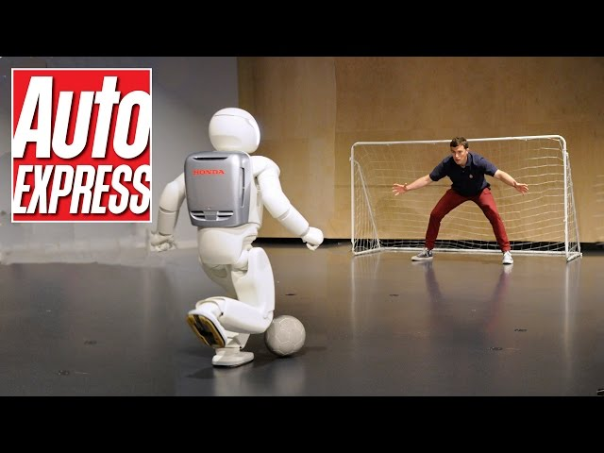
Honda Asimo

Slide 40
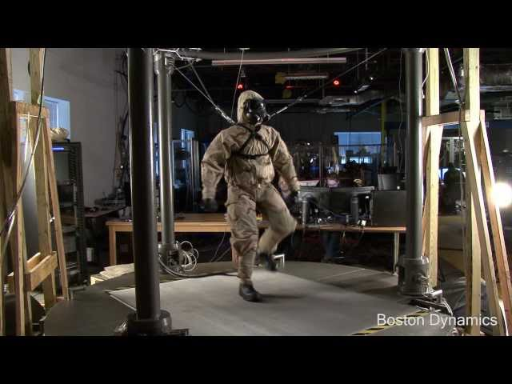
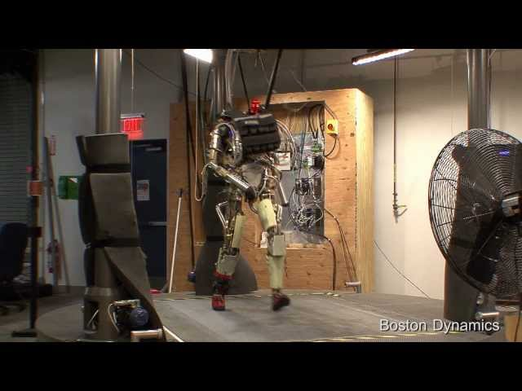
Boston Dynamics Petman

Slide 41
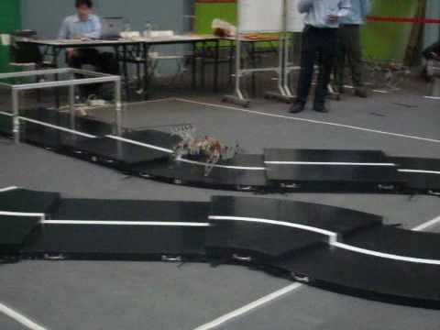
4+ Legs

Slide 42
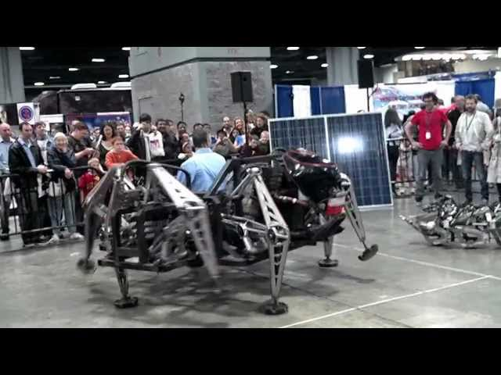
Spider Robot

Slide 43
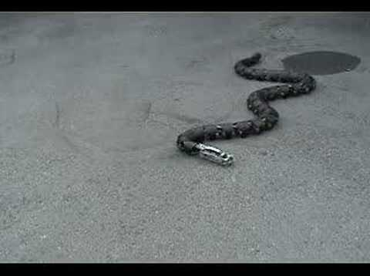
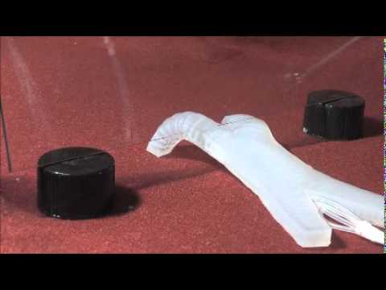
Other Robot Mobility
Sliding
Crawling
Fixed Wings
Rotary Wings

